Slide 1
Aquatic Invertebrates Identification and Microscope images
Mike Galaviz Artiaga
III/1/2015

Slide 2
Trichoptera (Caddisflies) Information
Larva form live in the water while the adult form are terrestrial. Larva do not have wings but the adults produce wings. Wings may have hair or appear scaly.
Young Trichoptera feed on detritus, water plants, and some feed on smaller organisms. Adult Trichoptera mandibles are reduced and they can no longer consume solid foods. They primary worry about reproducing and laying eggs into the water. Rarely feeds.
Larva can build cases (houses) out of materials such as, rocks, sediment, dirt, wood, etc… Theses Trichoptera are primary herbivorous and are usually found in calm waters.
Other larva are “web-spinners” (carnivorous) and eat captured prey that becomes trapped in their net. Due to this characteristic you would likely find them in flowing bodies of water.
Shares some of the life cycle characteristics as the order Lepidoptera. Larva eats till maturity getting filled on food; larva pupates (much like a Lepidoptera) in a cocoon made of silk; the pupa uses it mandibles to chew through the cocoon and swims to the surface; Adult arises from the cocoon, matures into final stage and is able to reproduce.

Slide 3
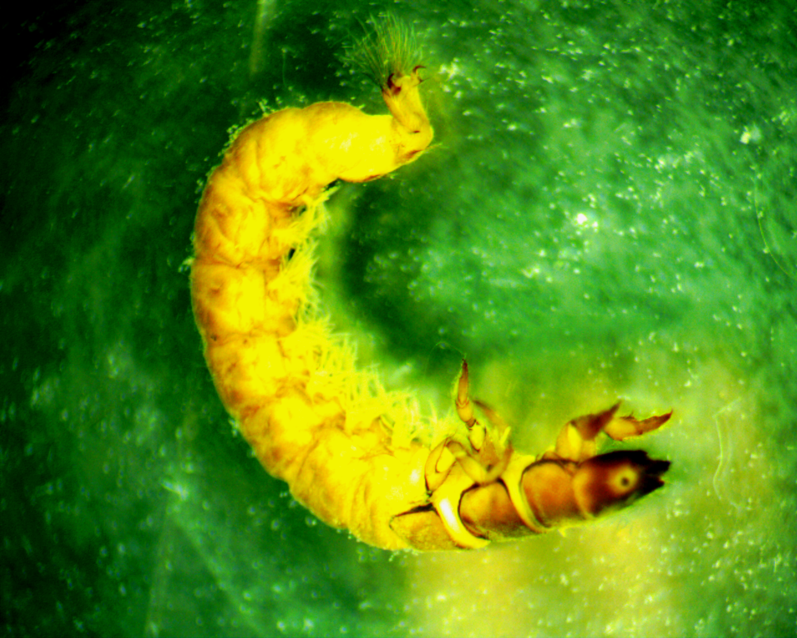
Trichoptera Hydropsyche SA River, Mission Road, Espada II-22-2012
Trichoptera classification
Shell or exoskeleton present; legs present
Jointed legs present
3 pairs of jointed legs present on thorax; prolegs present
Possessing neither wings nor wing pads, compound eyes absent
Abdominal prolegs; often residing in cases
Importance to the ecosystem
They are food for other organisms such as fish
They are used in the EPT test to determine the level of pollution in bodies of water
They have a low tolerance of pollution

Slide 4
Examination of Trichoptera 1. No compound eyes 2. No wings or wings pads 3. 3 pairs of jointed legs present on thorax 4. Prolegs present and residing towards the posterior
1
2
3
4

Slide 5
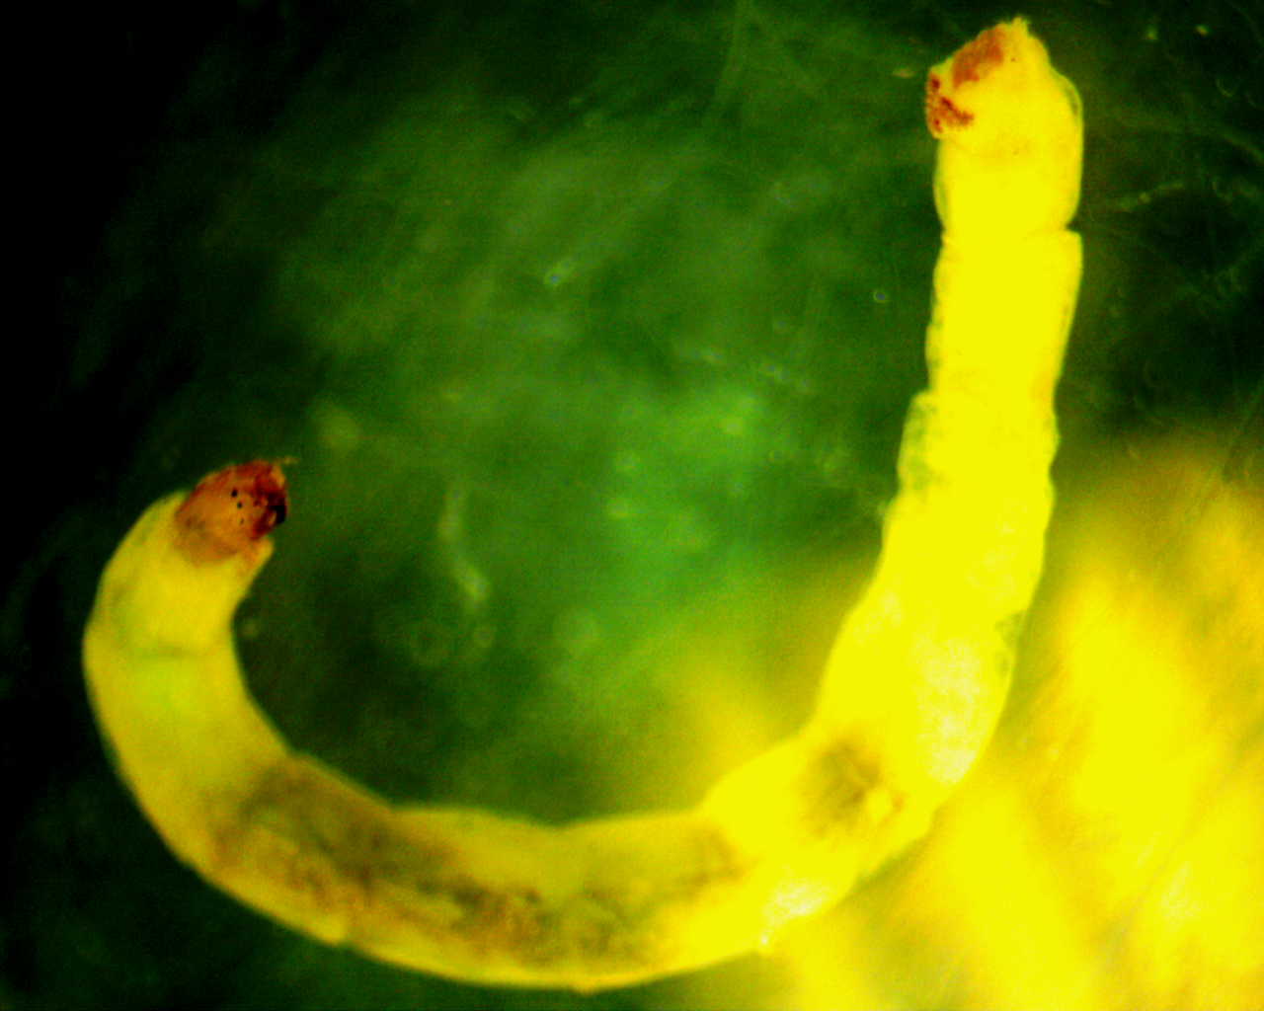
Diptera (Pseudosmittia) SA River Mission Espada
Diptera classification
No shell or exoskeleton present; legs absent
No sucker disk visible, body rounded, worm-like
Head capsule visible; no jointed legs present on thorax
No prolegs

Slide 6
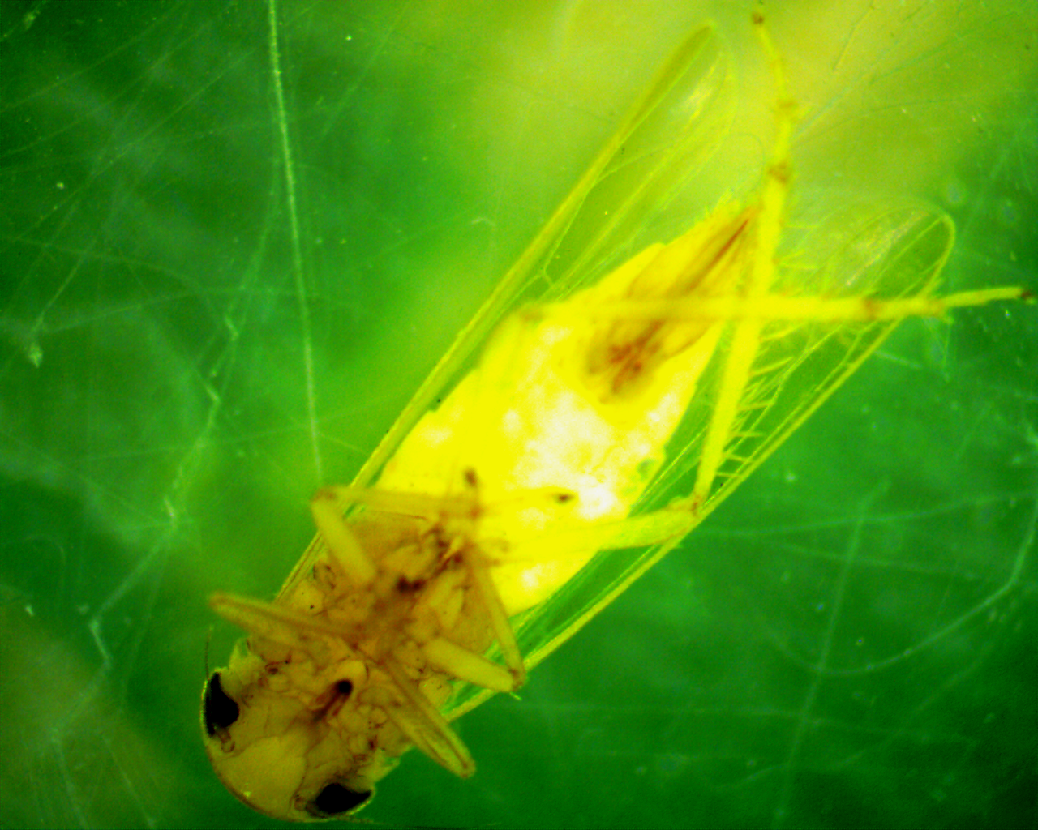

Slide 7
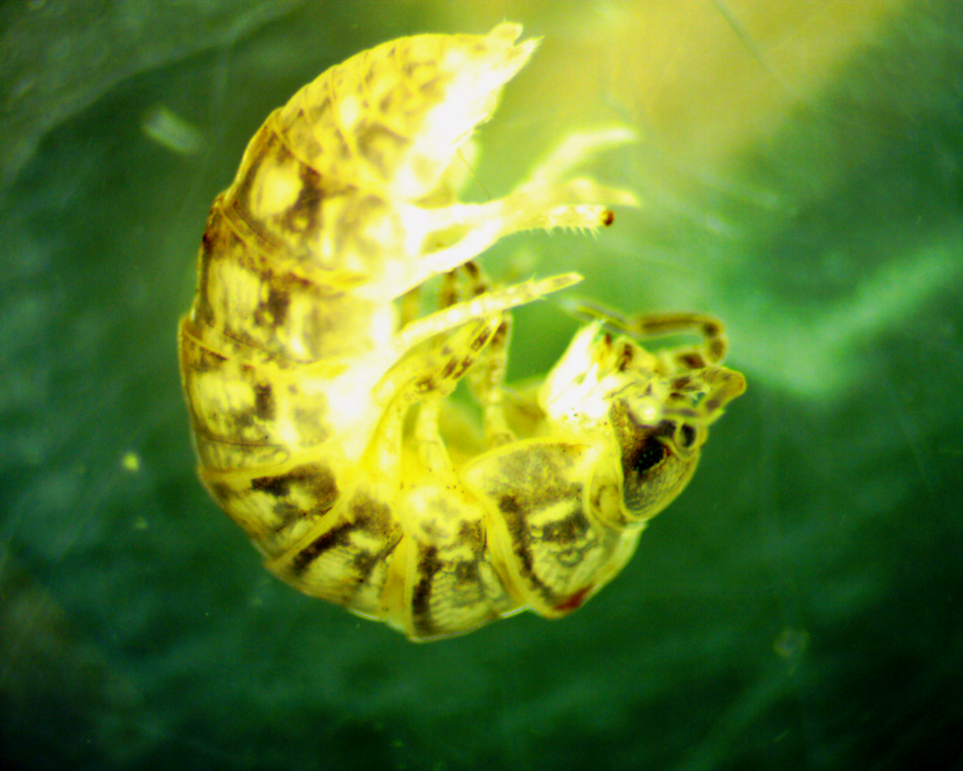
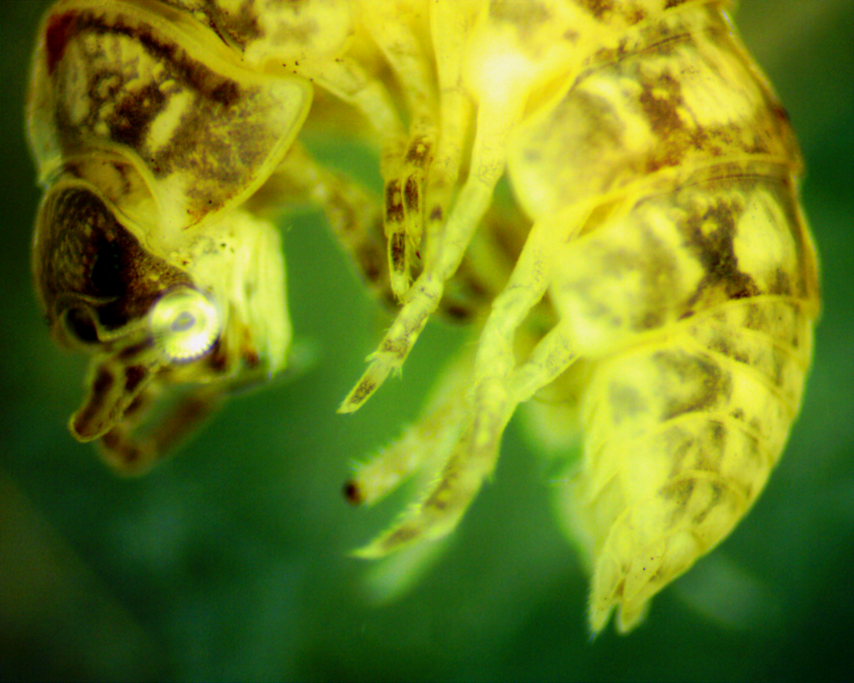
Isopoda (Sow bugs)

Slide 8
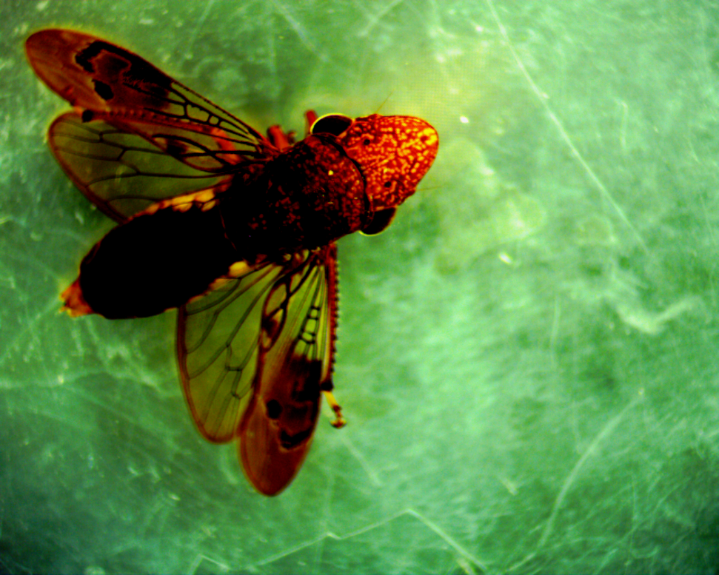
Plecoptera (Taeinopterygida) 2013

Slide 9
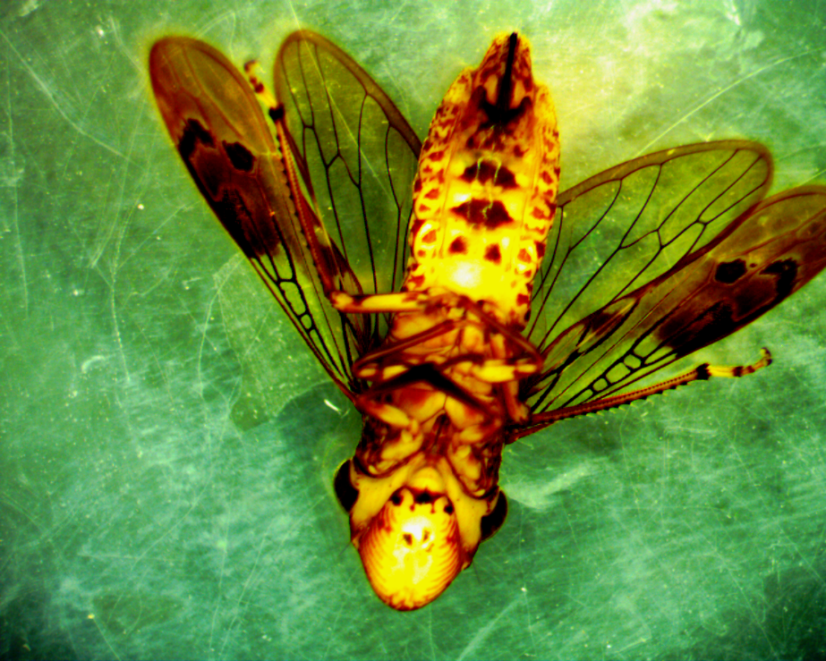
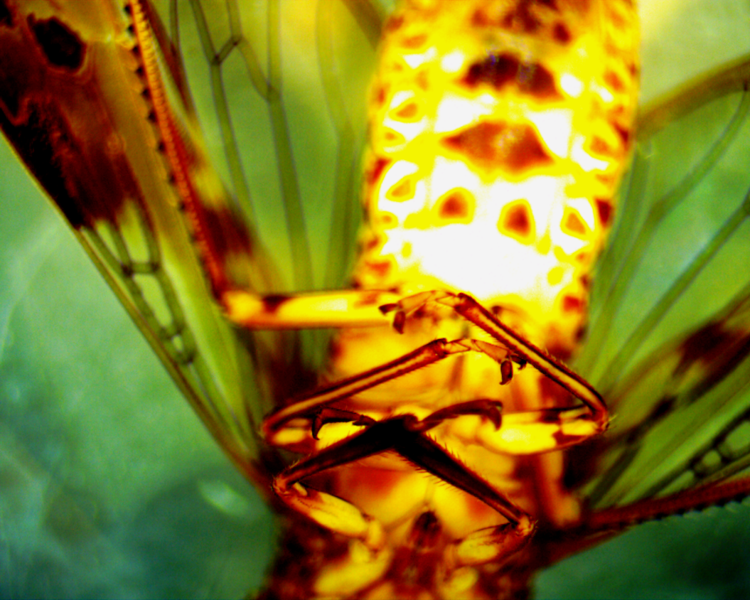
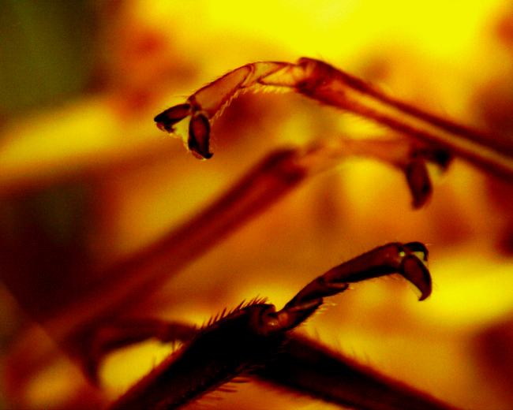

Slide 10
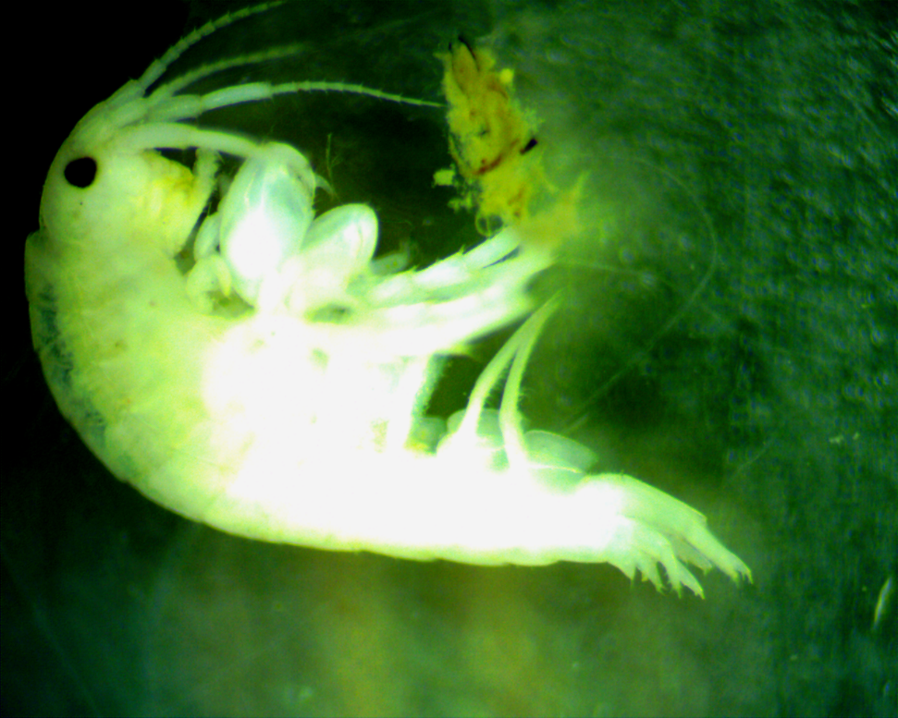
Amphipoda (Scuds)

Slide 11
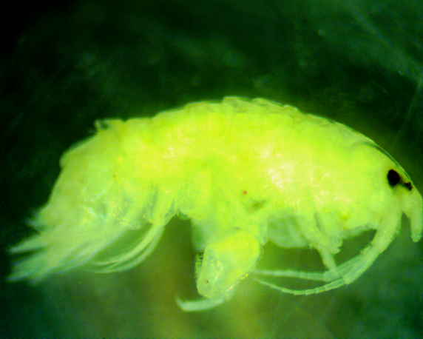
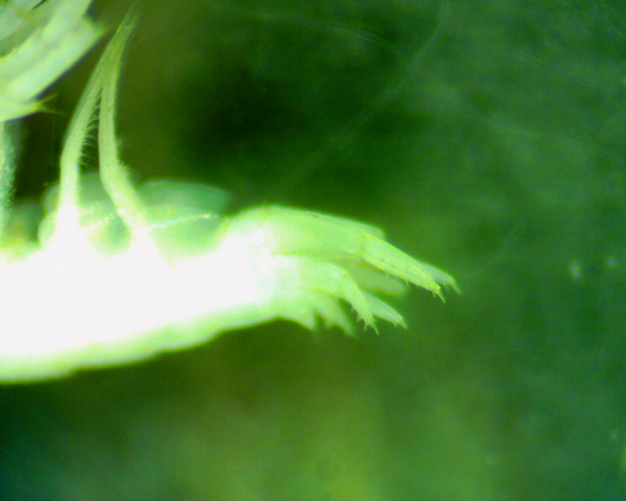
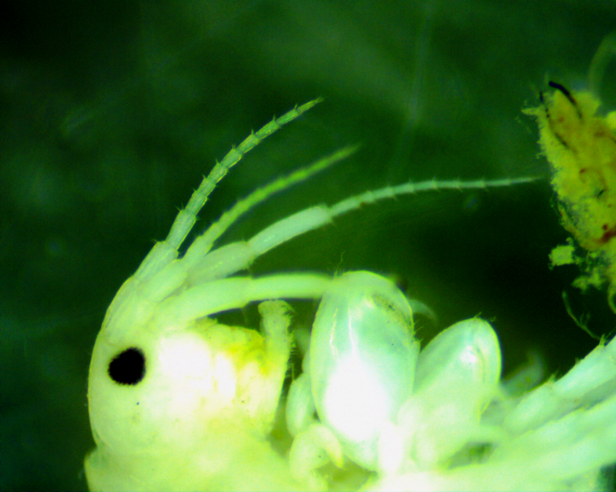
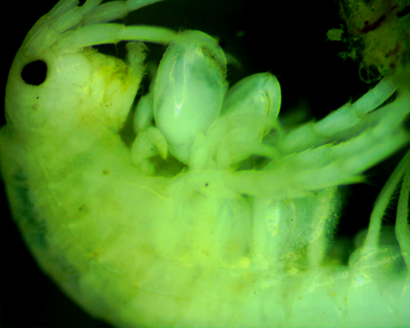

Slide 12
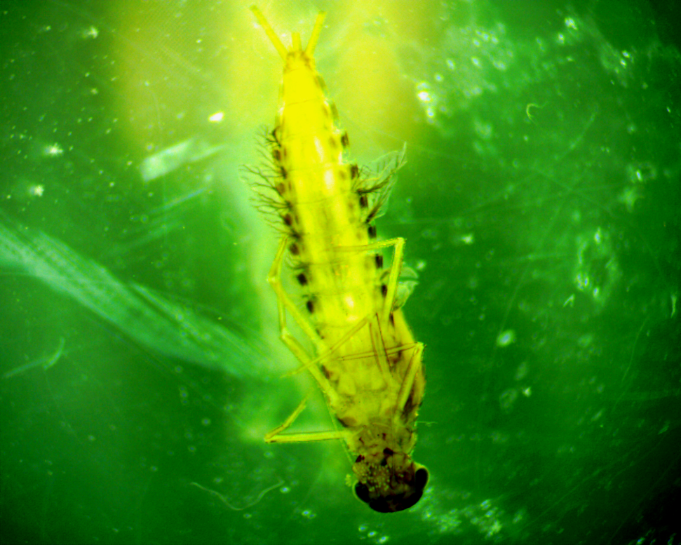

Slide 13
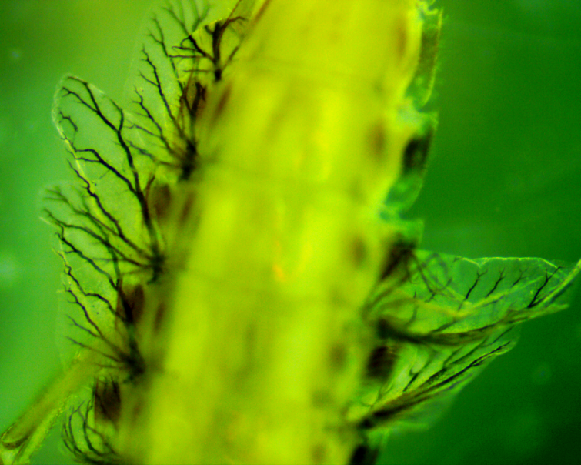
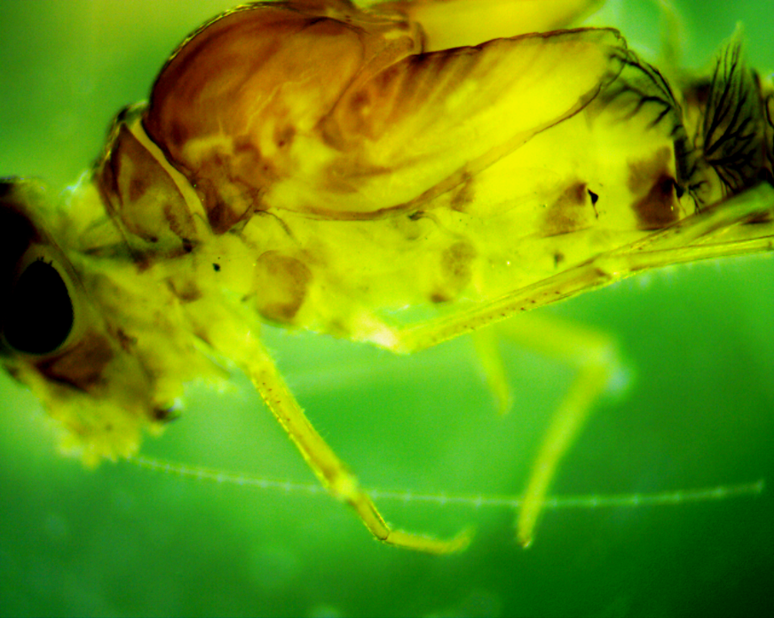
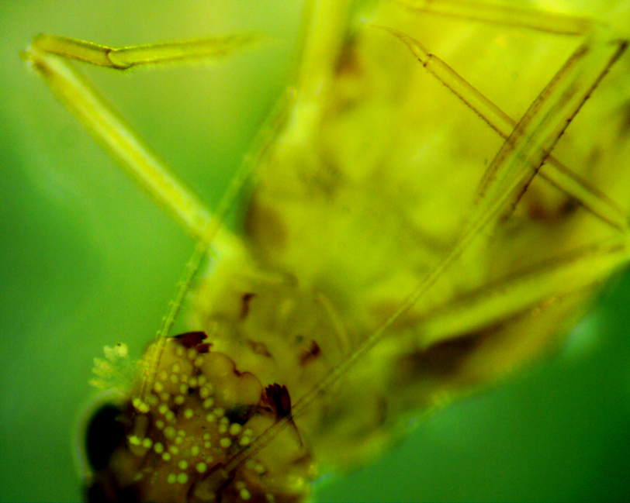
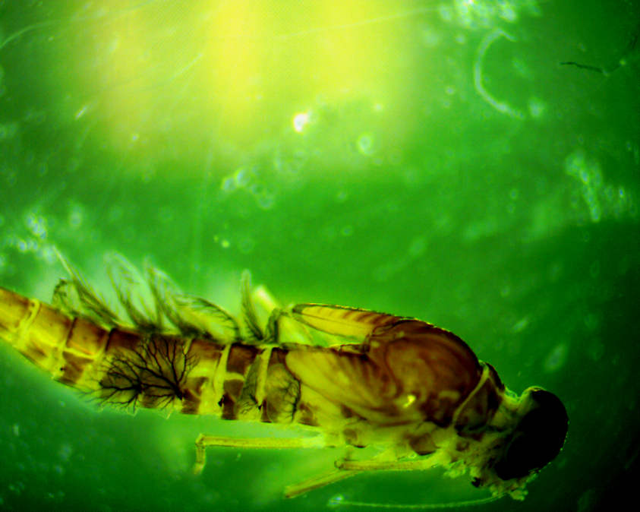

Slide 14
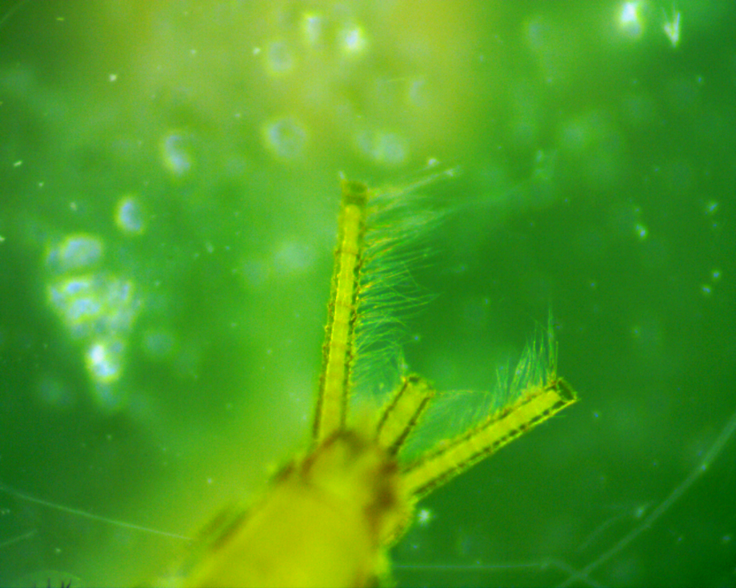
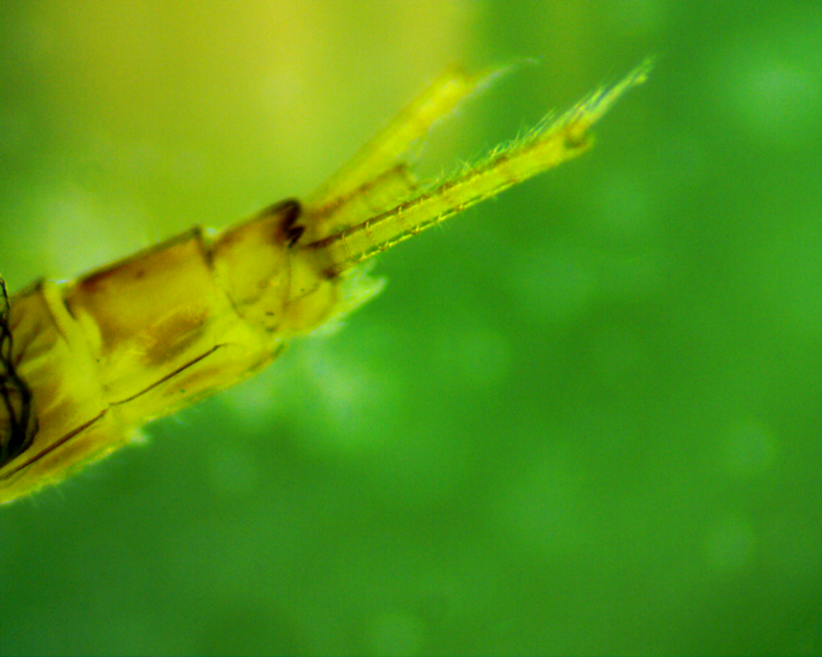
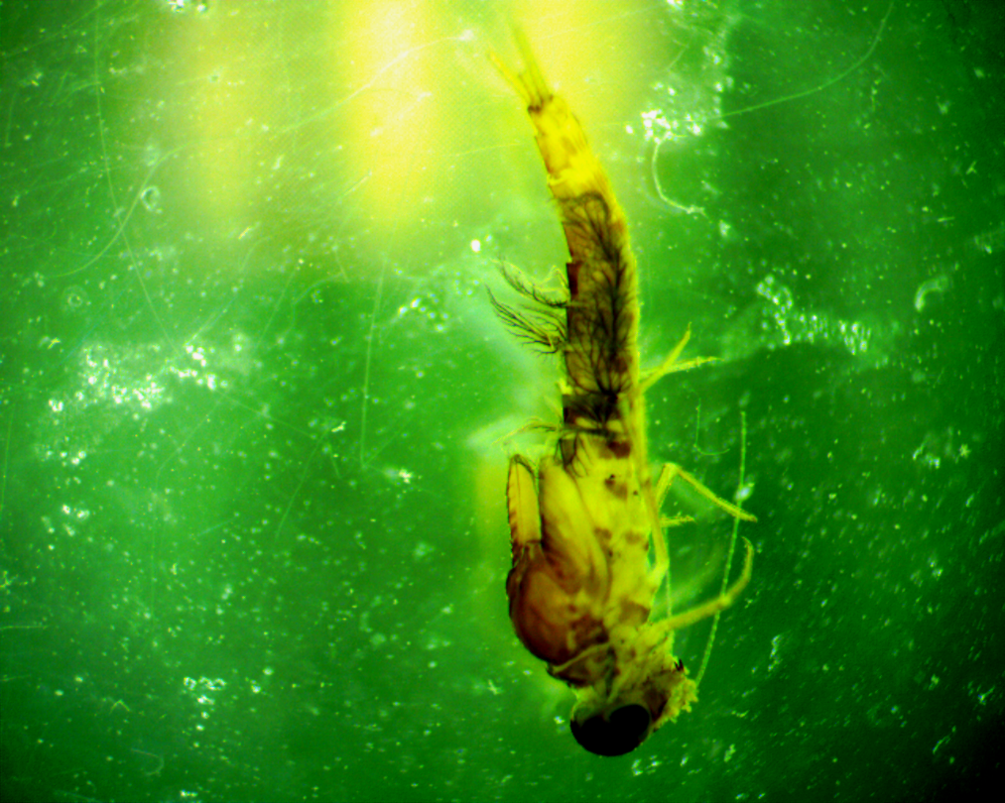
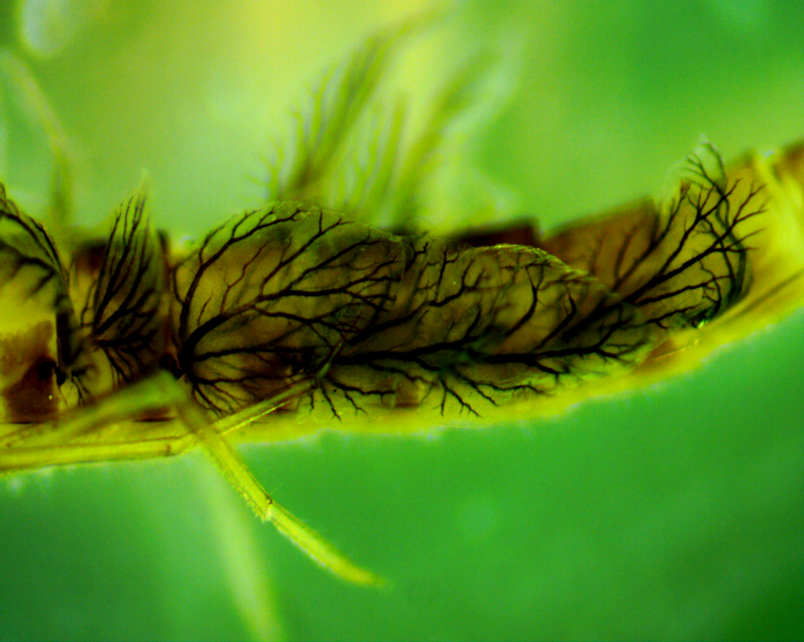

Slide 15
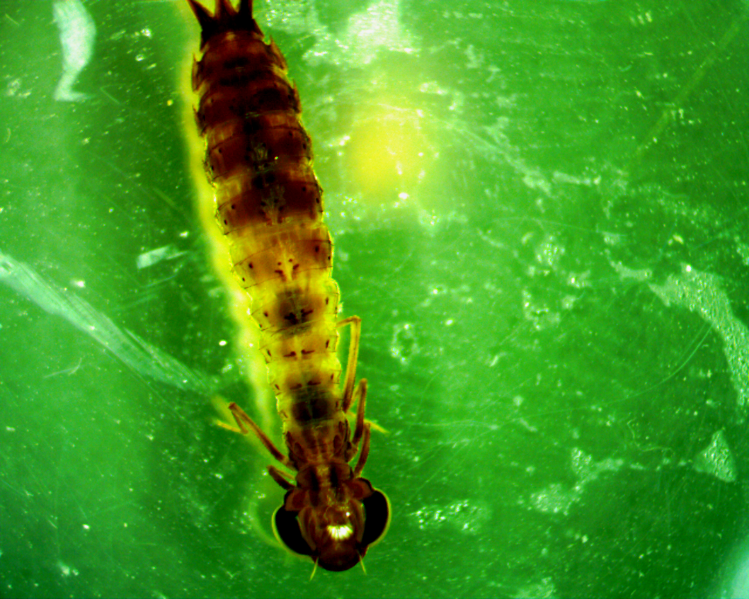
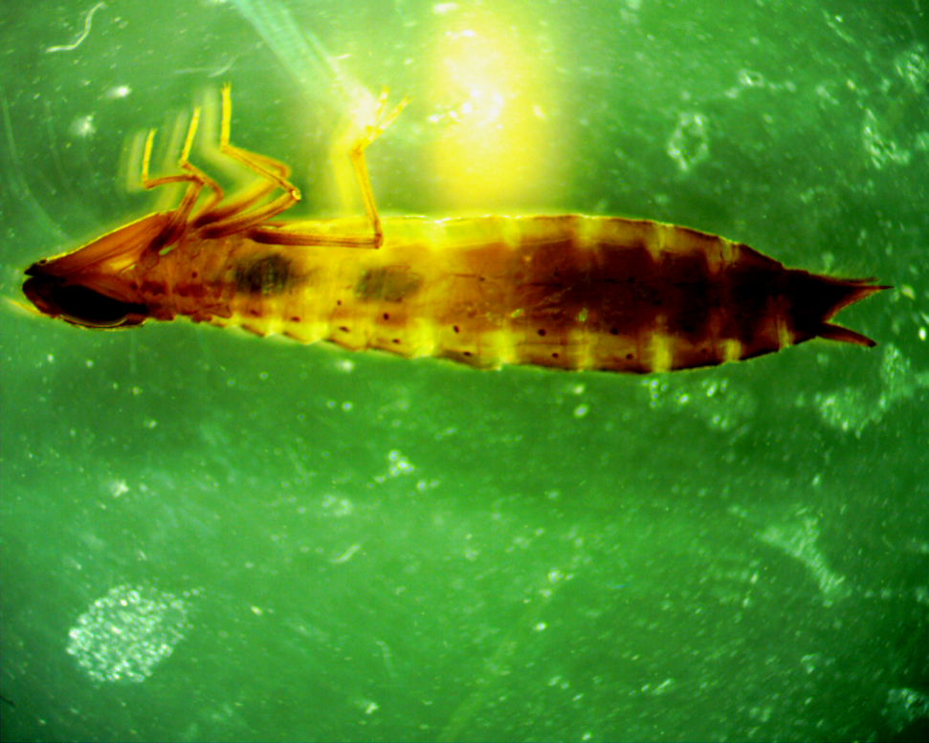
Odonata (Dragonflies)

Slide 16
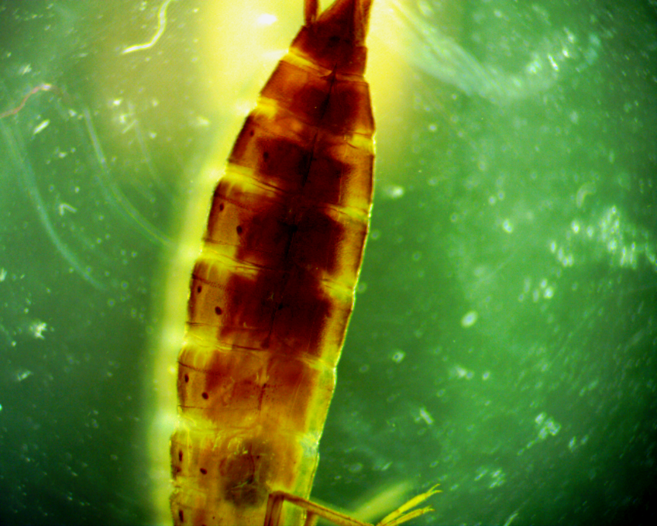
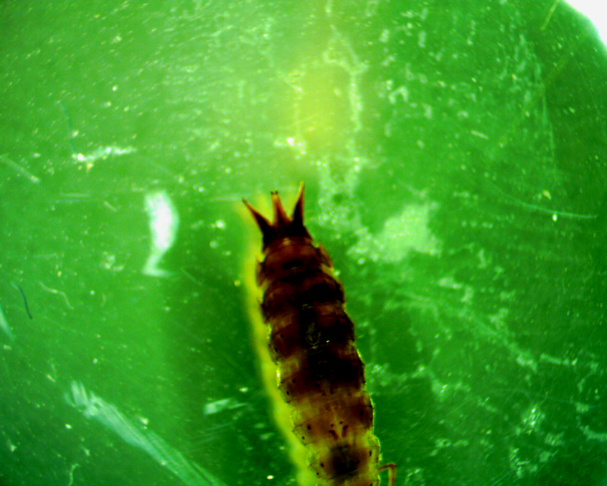
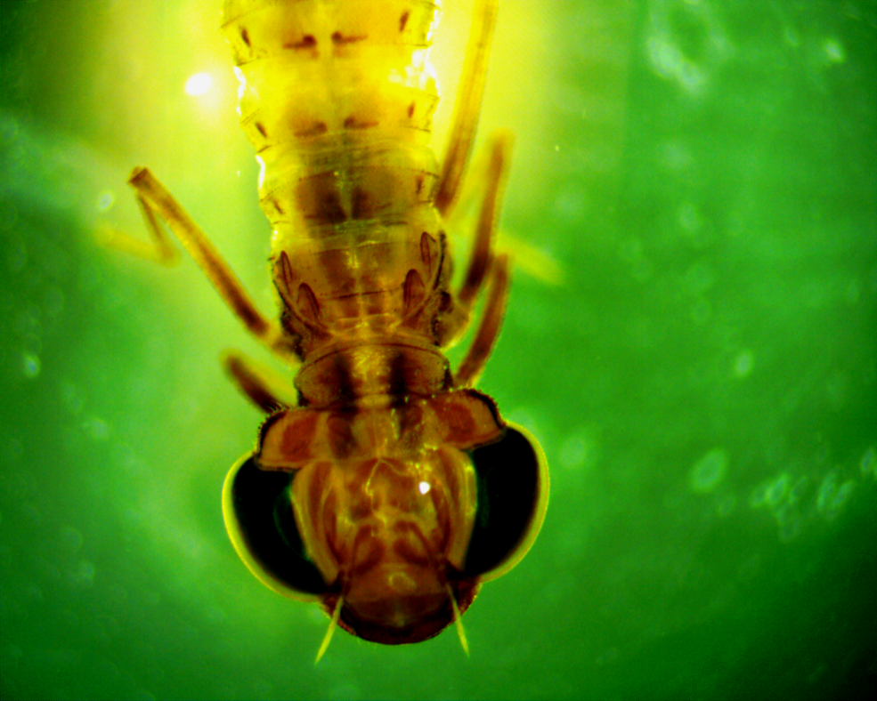
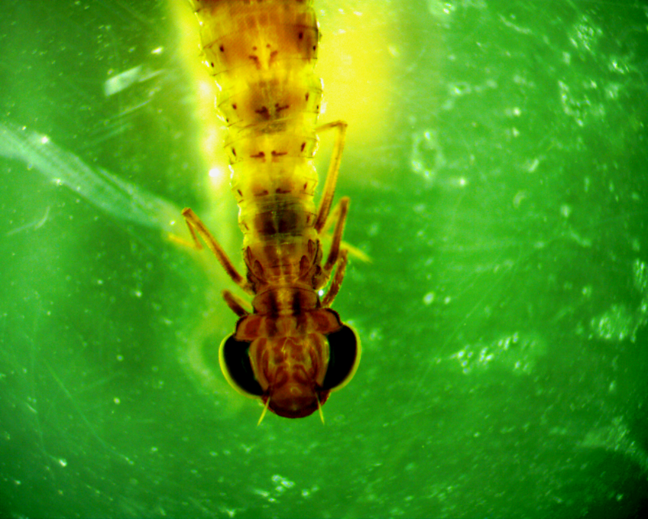

Slide 17
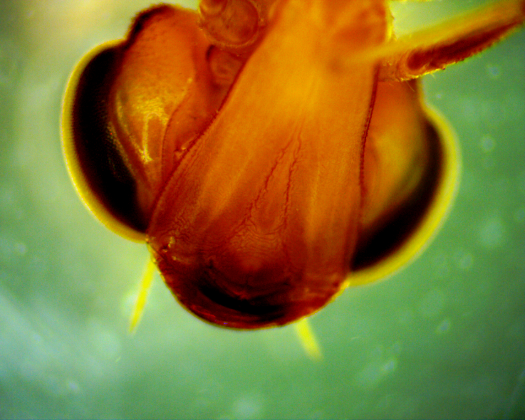
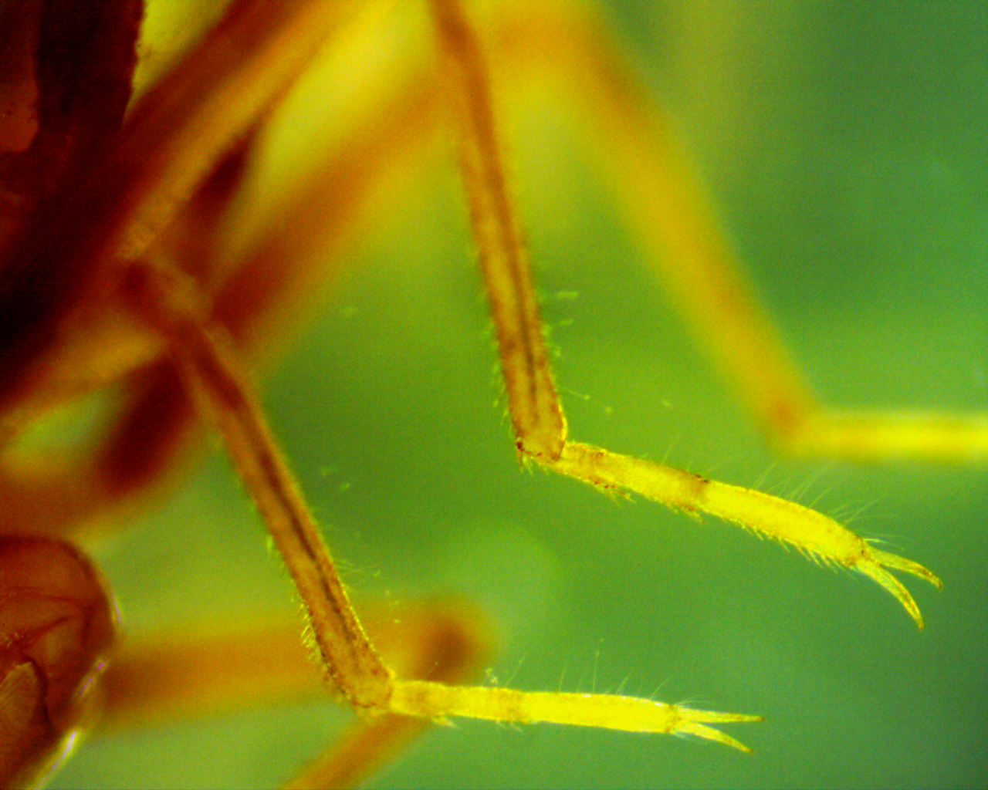
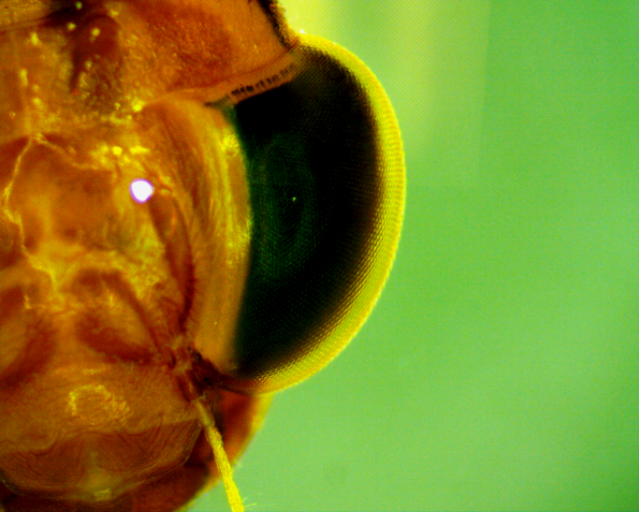

Slide 18
Hemiptera Notonectidae Notonecta

Slide 20
